Slide 1
Utilizzo dei dati EMODnet nel sistema di previsione oceanografica dell’UK Met Office
Marina Tonani
Manager Shelf Seas Forecasting
EMODNET Italia, 22nd May 2018

Slide 2
Topics:
Met Office ocean forecasting systems
EMODnet-physics data for model validation
EMODnet-bathymetry for high resolution model

Slide 3
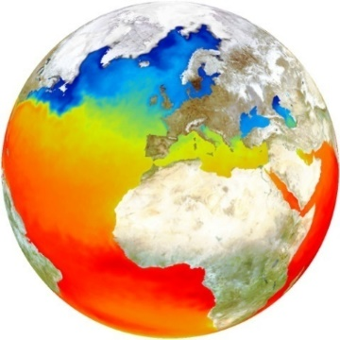
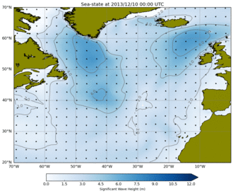
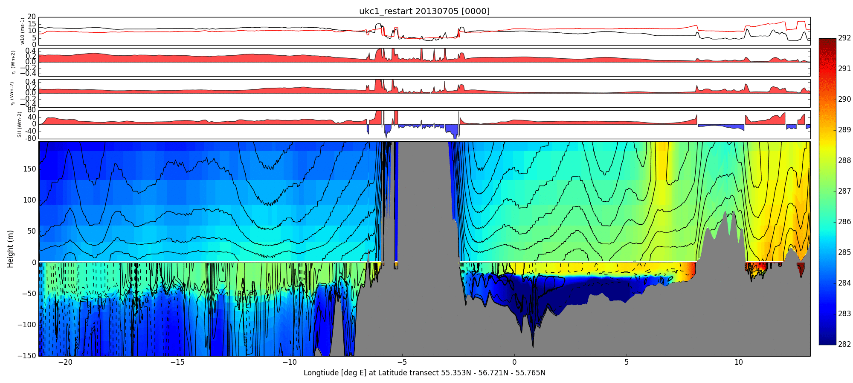
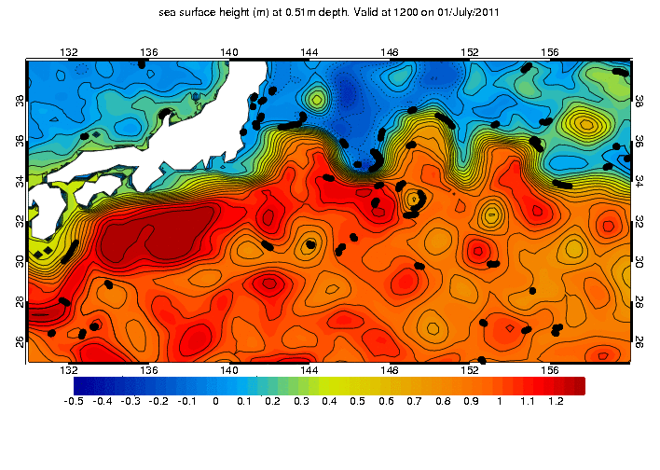
Models and Systems
Surface waves based on NCEP’s WAVEWATCH III®
  Runs 4 x daily, including an ensemble
Storm surge based on POLCOMS (moving to NEMO)
  Runs 4 x daily, including an ensemble
SST & sea-ice satellite and in situ obs analysis (OSTIA)
  foundation SST and diurnal temperature
Ocean (FOAM) using NEMO-CICE with NEMOVAR data assimilation
  3D monitoring and prediction, including biogeochemistry
Coupled Atmosphere-Ocean-Wave-Ice-Land research systems

Slide 4
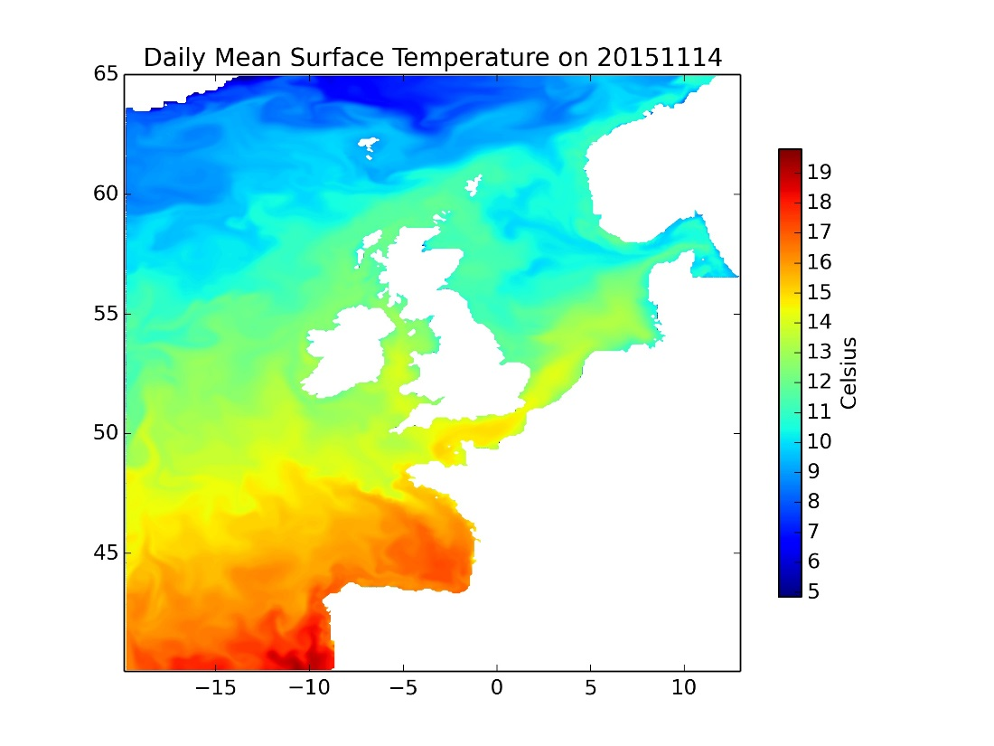
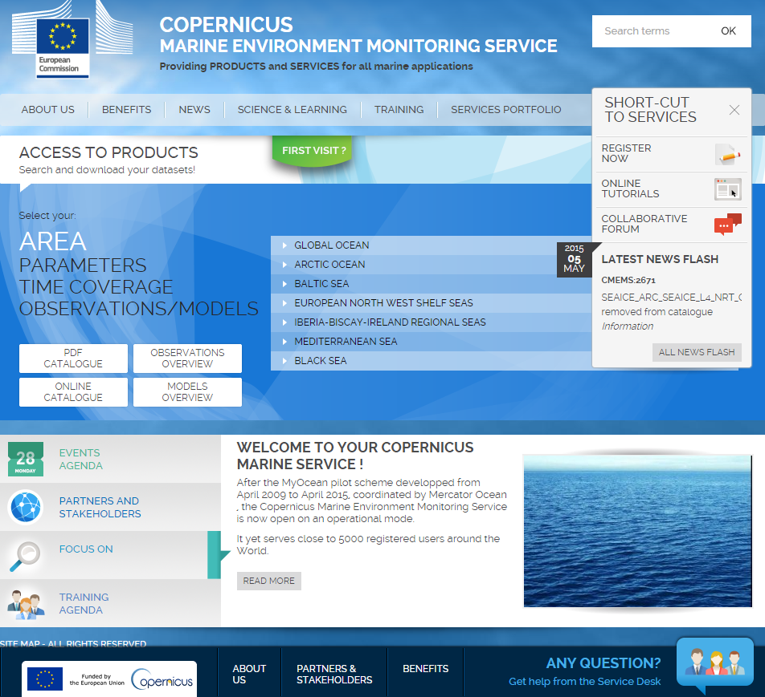
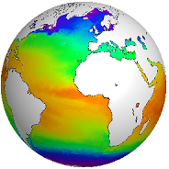
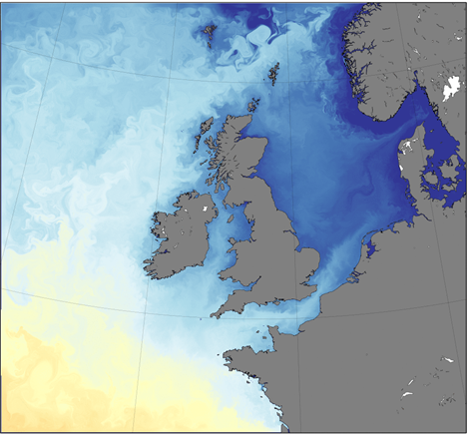
https://marine.coperncus.eu
Copernicus Marine Environmental Monitoring Service
Successfully operating:
North-West Shelf
Coupled global
Notes:
NWS MFC - -model based forecasts and (re)analysis
Global SST/Ice = OSTIA
Global In Situ – Nick rayner in climate with Enact (EN4)
Global Coupled – coupled NWS, ORCA025-N216 -→

Slide 5
HF Radar for model validation

Slide 6
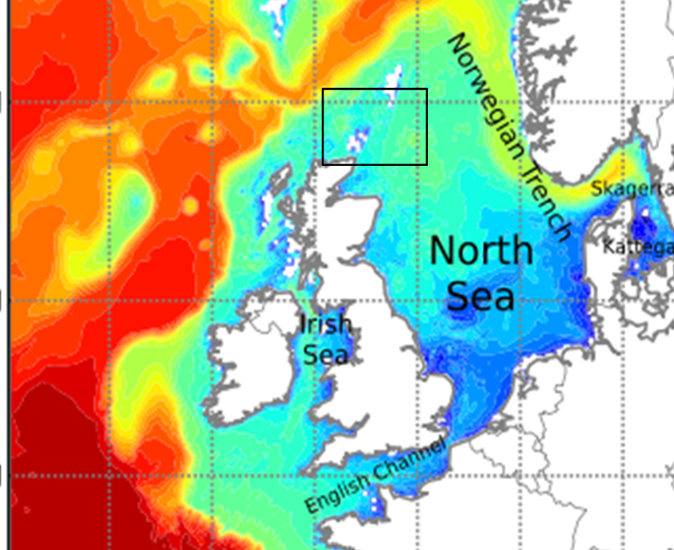
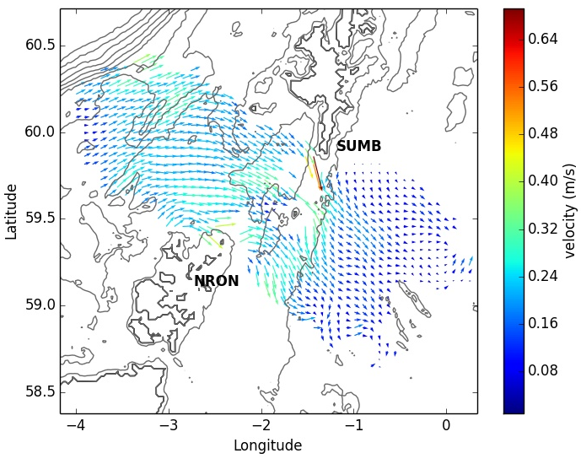
Verification of surface currents using HF radar current velocities
Low frequency currents
Shetland
Orkney
8 Dec 2013
Courtesy of C. Pequignet
Methodology was developed using a data from North Scotland and will be applied to dataset from ongoing HF radar networks.
Notes:
NWS MFC - -model based forecasts and (re)analysis
Global SST/Ice = OSTIA
Global In Situ – Nick rayner in climate with Enact (EN4)
Global Coupled – coupled NWS, ORCA025-N216 -→

Slide 7
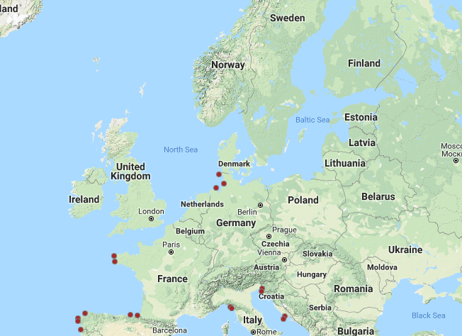

Verification of surface currents using HF radar current velocities
Existing HF radar facilities in NWS region
Making use of existing HF radar data to verify surface currents
Comparing various configurations of FOAM-AMM
Need to automate the uptake of HF radar data, to have near real time multi-model verification
Notes:
NWS MFC - -model based forecasts and (re)analysis
Global SST/Ice = OSTIA
Global In Situ – Nick rayner in climate with Enact (EN4)
Global Coupled – coupled NWS, ORCA025-N216 -→

Slide 8
Model bathymetry

Slide 9
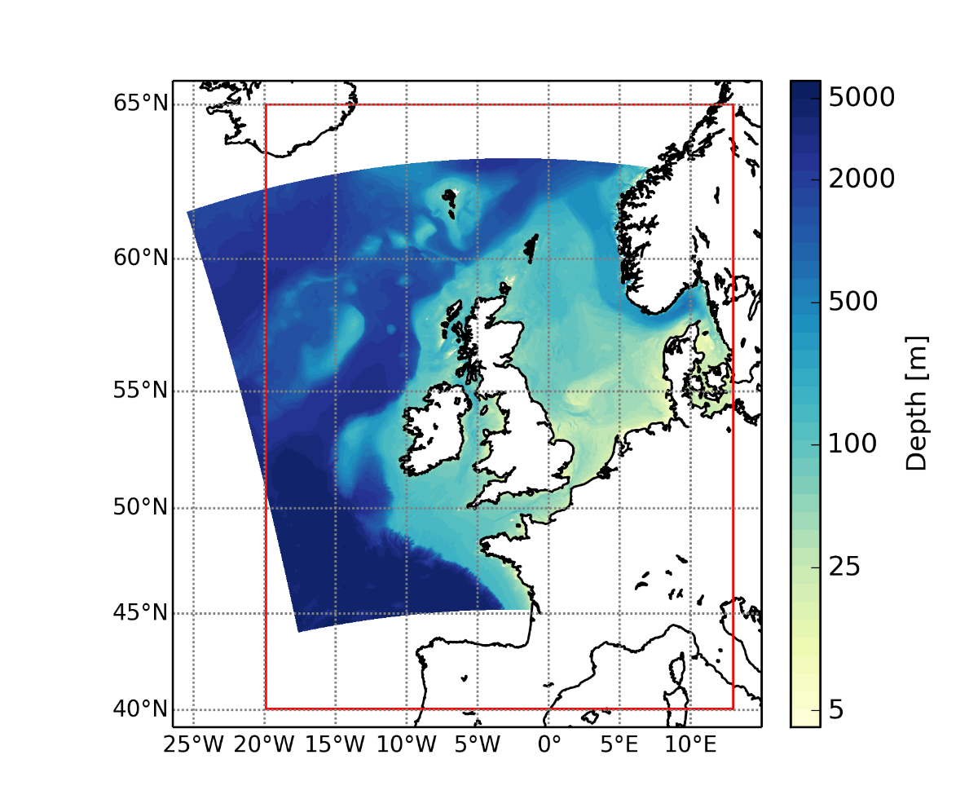
North West Shelf at 1.5km
Regional configuration of NEMO ocean model (v 3.6).
New, higher resolution bathymetry and coastline.
  EMODnet: European Marine Observation and Data Network.
  AMM7 bathymetry based on NOOS: NW Shelf Operational Oceanographic System.
Note: no change in vertical resolution (both have 51 S-levels.)
AMM7
Soon available in Copernicus Marine
Notes:
Note adjustment for MSL with EMODnet

Slide 10
North West-European shelf 1.5 km
Improved bathymetry: impact on tides, topographic steering, mixing etc.
Note: both models use 51 σ-levels.

Slide 11
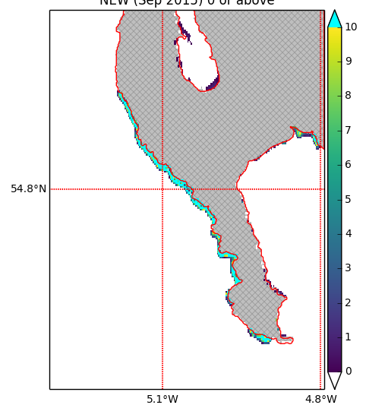
North West-European shelf 1.5 km with wetting and drying
In regions where the tide is important, the treatment and the representation of the wetting and drying process within the model is crucial to have an accurate description of the local dynamics.
There are some issues with negative depth bathy in recent EMODNET data → in near coastal locations there are points that are sea but have very large negative depths.
Reference: Low Astronomical Tide
Ireland-west coast

Slide 12
Conclusion

