Slide 1
MWM – Mediterranean Wind-Wave Model
Previsione e ricostruzione multi-decennale a medio-alta risoluzione spazio-temporale dei campi di onda e di vento sul Mare Mediterraneo.
Risultati di una partnership pubblica privata
- Dipartimento di Ingegneria e Architettura, UniTS - Partner tecnico-scientifico Giorgio CONTENTO
- Danish Hydraulic Institute (Genova) - Partner tecnico-scientifico-commerciale
EMODnet – Trieste, Giugno 2018

Slide 2
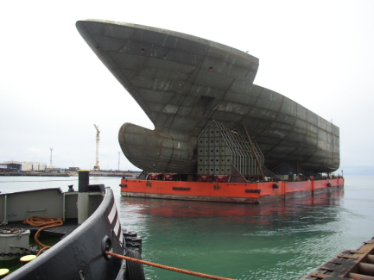
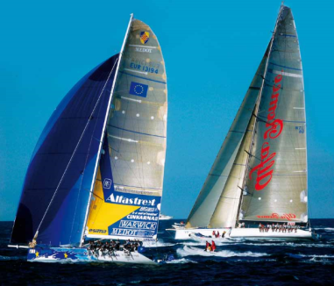
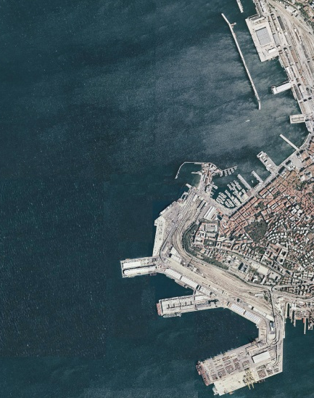
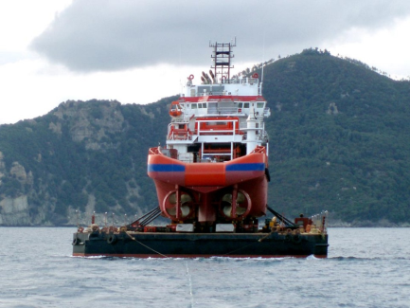
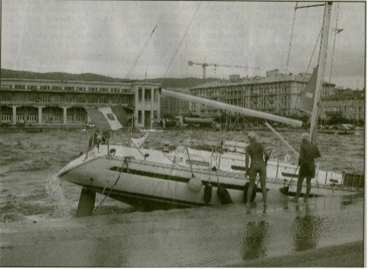
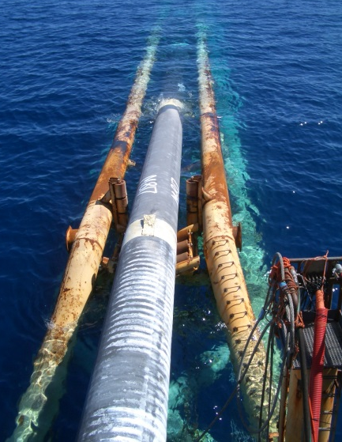
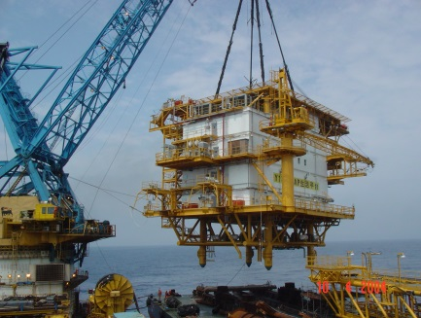
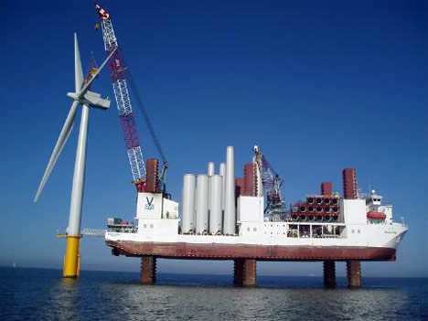
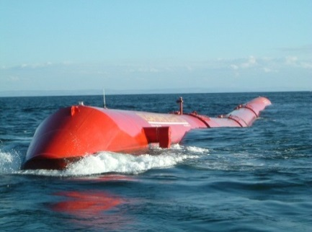
WIND-WAVE MODELS: WHY / Where / when
Offshore Operations
Special Transportations
Ship/Offshore Design/Planning
Weather Routing (safety/comfort/green)
Ocean Energy Exploitation
Harbour Design/Operations
Civil Protection
Pleasure/Pro Sailing

Slide 3
WIND-WAVE MODELS: WHY MWM?
REQUIREMENTS FROM END (INDUSTRIAL) USERS
Space / time resolution
Accuracy: both wind-wave climate and storm peaks
Customization of the service (high res. model nesting, fast and cheap data delivery, …)
Expertise in dealing with ship/offshore/shore post-processing applications
…
TECHNICAL & SCIENTIFIC REQUIREMENTS
HW ($ / handling / life cycle)
SW (set-up / testing / V&V)
Storage / Database maintenance and updates
Data Security
...

Slide 4
WIND-WAVE MODELS: MWM
DataSet
Mediterranean Sea
39 years of wind/wave data
(1979 – 2017 monthly updated)
Hourly frames
< 0.1° resolution

Slide 5
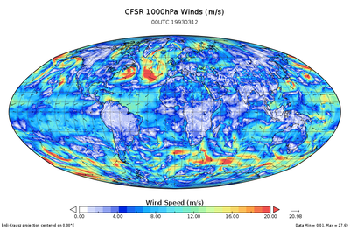
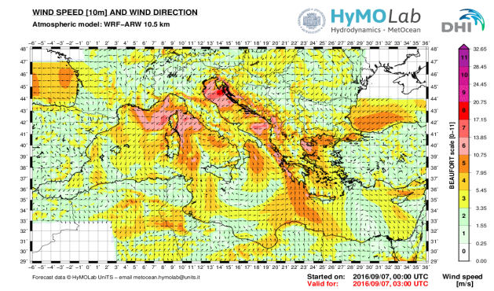
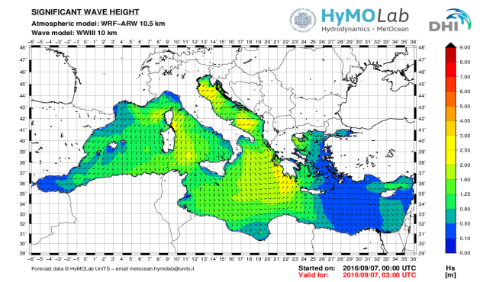
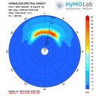
WIND-WAVE MODELS: MWM
Global Atmospheric Model
CFSR by NCEP (with Reanalysis) GFS by NCEP (with Data Assimilation) | Download | 0.5°
Saha, Suranjana, et. al. (2010)
The NCEP Climate Forecast System Reanalysis.
Bull. Amer. Meteor. Soc., Vol. 91, 1015-1057.
Initial and Boundary Conditions
Local Atmospheric Model
WRF-ARW | Simulation | Resol: 0.1°or lower
Michalakes J, et. al., (2005)
The WRF Model: Software Architecture and Performance.
In Proceedings of the 11th ECMWF Workshop on the Use
of High Performance Computing in Meteorology. 2005, 56 - 168.
Forcing term: wind speed at 10 m height
Wave Model
MIKE 21 SW WaveWatch III | Simulation | Resol: 0.1°or lower
Tolman H., (2009) User manual and system documentation of WAVEWATCH III® version 3.14. NOAA / NWS / NCEP / MMAB Technical Note 276.

Slide 6
WIND-WAVE MODELS: MWM
 | Task | Span | Validation Vs | State
A | Preliminary validation | 1 year (2000) | Ground stations & buoys | Completed
B | Extended validation | 11 years (2000 - 2010) | Satellites (altimeters) & buoys | Completed
C | Further improvements | 39 years (1979 - 2017) | Satellites (scattero/alti meters) & buoys | Continuous update
1979
1990
2000
2010
2017

Slide 7
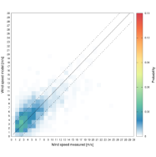
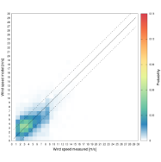
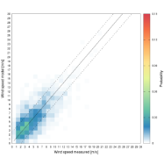
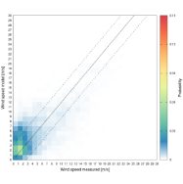
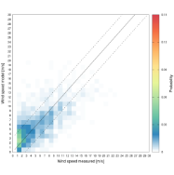
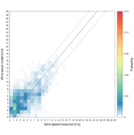
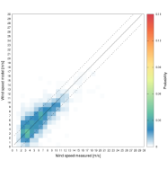
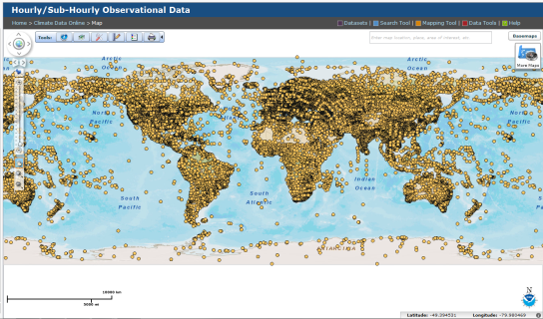
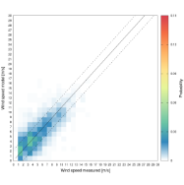
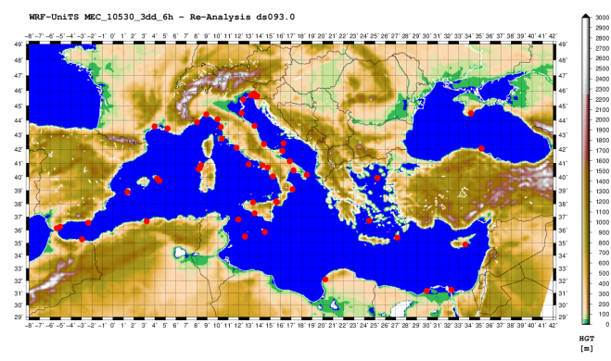
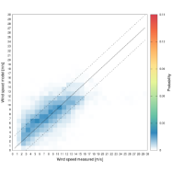
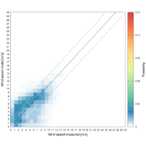
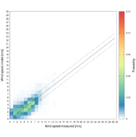
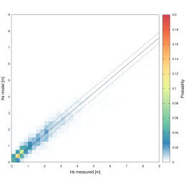
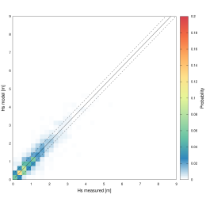
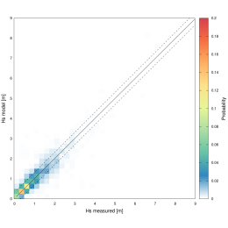
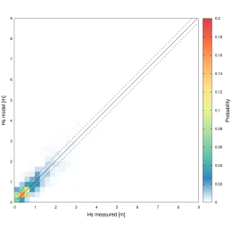
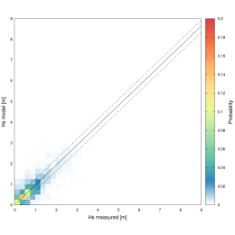
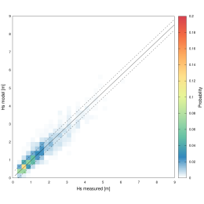
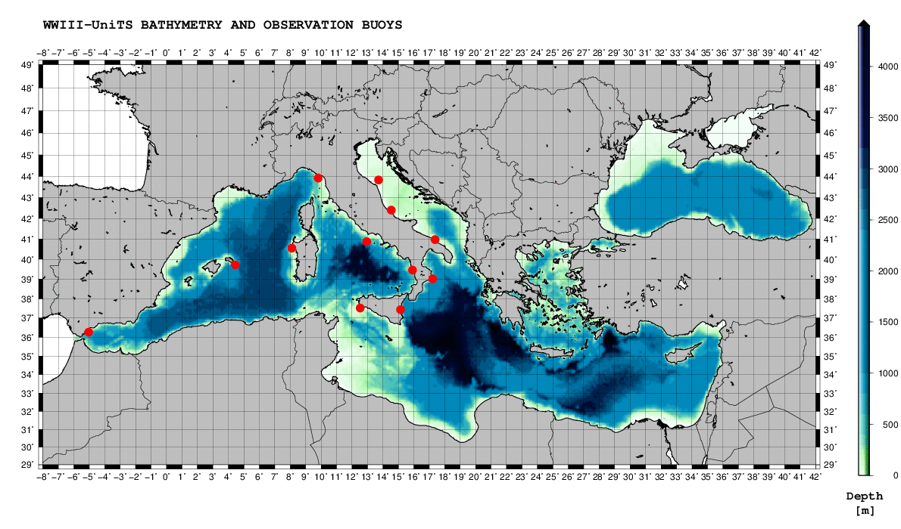
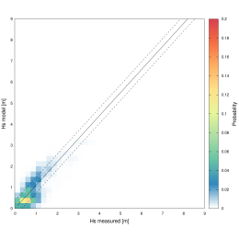
WIND-WAVE MODELS: MWM
WIND
DATA SOURCE:
Capo Caccia
Montpellier
Ponza
Trieste
Palagruza
Crotone
Limnos
Malta
Karpatos
Phase A
Alboran
http://gis.ncdc.noaa.gov/
Alessandria d’E.
WAVES
Alghero
Mazara
Ponza
Ancona
Ortona
Monopoli
Cetraro
RON, PdE, …
Mahon
Crotone
Alboran
Catania

Slide 8
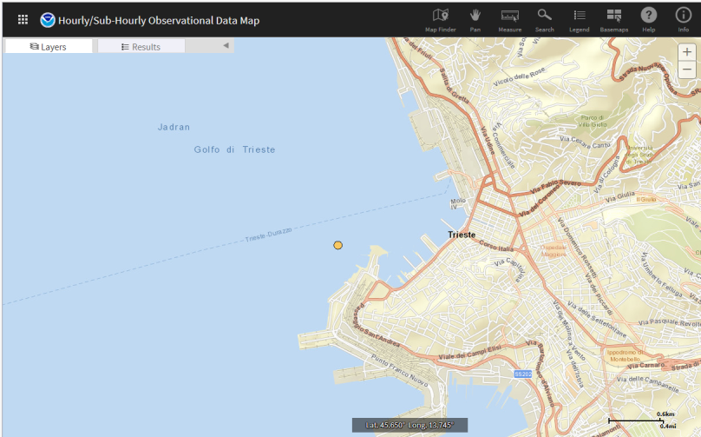
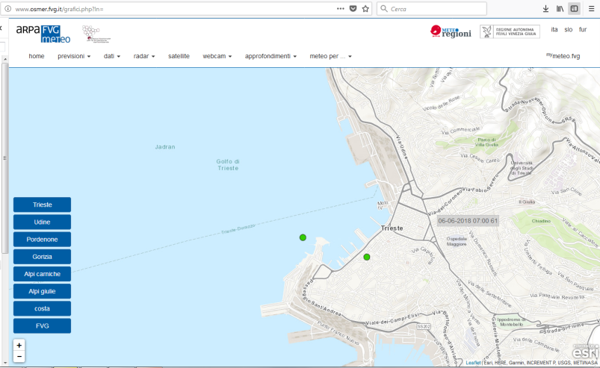
WIND-WAVE MODELS: MWM
ISSUES:
Heterogeneous quality of the exp. data (time series)
Heterogeneous quality of the comparison with model data
Possible influence of orography, shadowing, …
CASE HISTORY:
Phase A

Slide 9
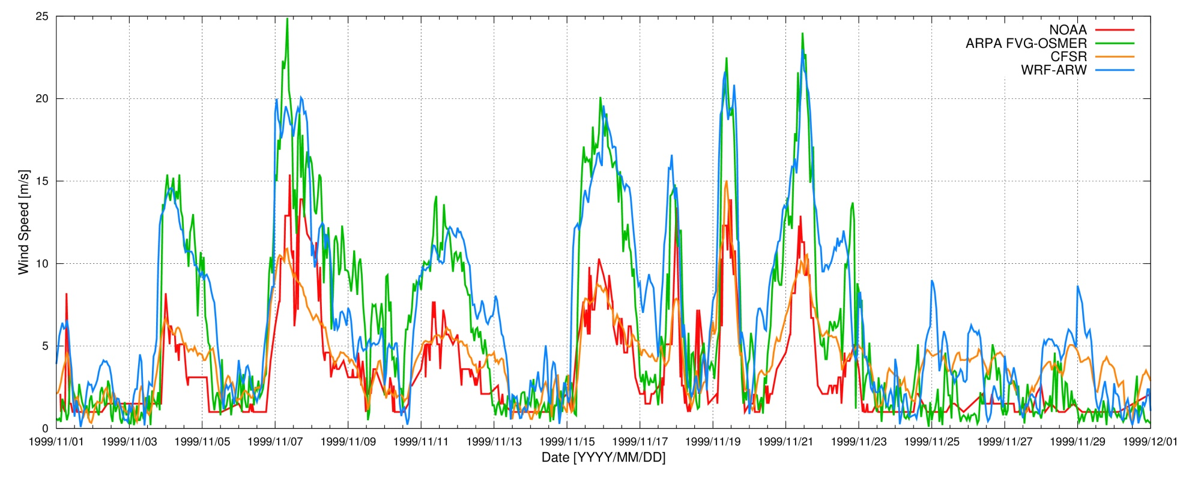
WIND-WAVE MODELS: MWM
ISSUES:
Heterogeneous quality of the exp. data (time series)
Heterogeneous quality of the comparison with model data
Possible influence of orography, shadowing, …
CASE HISTORY:
Phase A

Slide 10
WIND-WAVE MODELS: MWM
 | Task | Span | Validation Vs | State
A | Preliminary validation | 1 year (2000) | Ground stations & buoys | Completed
B | Extended validation | 11 years (2000 - 2010) | Satellites (altimeters) & buoys | Completed
C | Further improvements | 39 years (1979 - 2017) | Satellites (scattero/alti meters) & buoys | Continuous update
1979
1990
2000
2010
2017

Slide 11
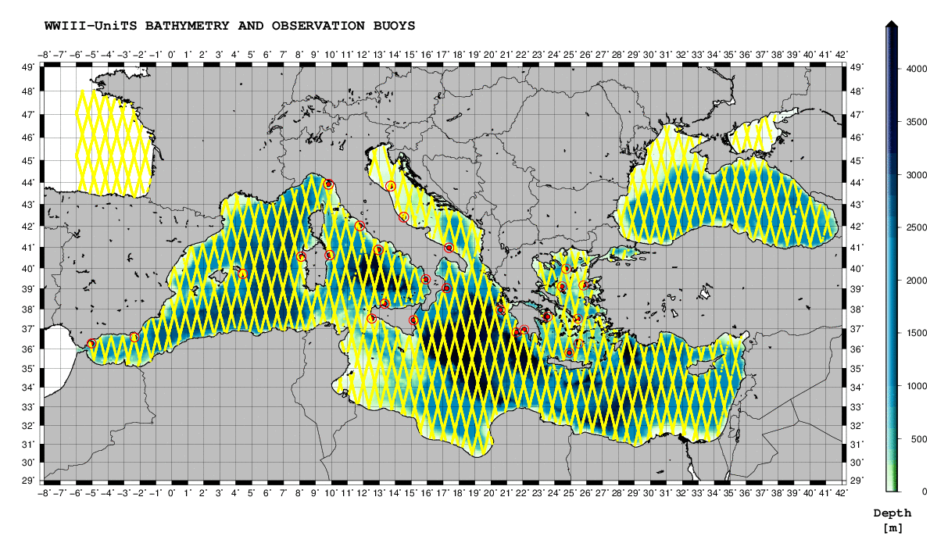
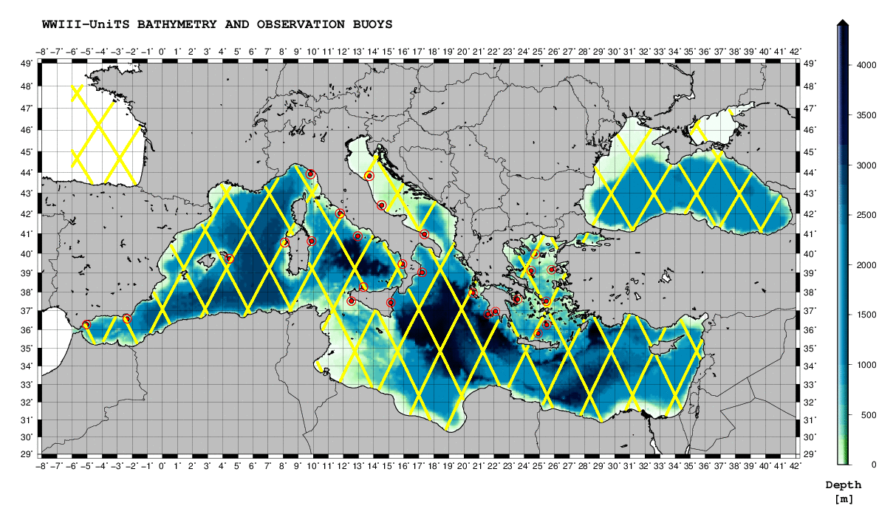
WIND-WAVE MODELS: MWM
GEOSAT
Jason-1
Phase B
DATA SOURCE:
http://cersat.ifremer.fr/
Satellites | Characteristics
ENVISAT ERS-2 GEOSAT Jason-1 Jason-2 TOPEX | Altimeters (sensors) Ground speed: ≈ 7 km/s Repeat cycle: 10 ÷ 30 days Ground track separation: 80 ÷ 300 km Significant wave height Wind speed
Parameters

Slide 12
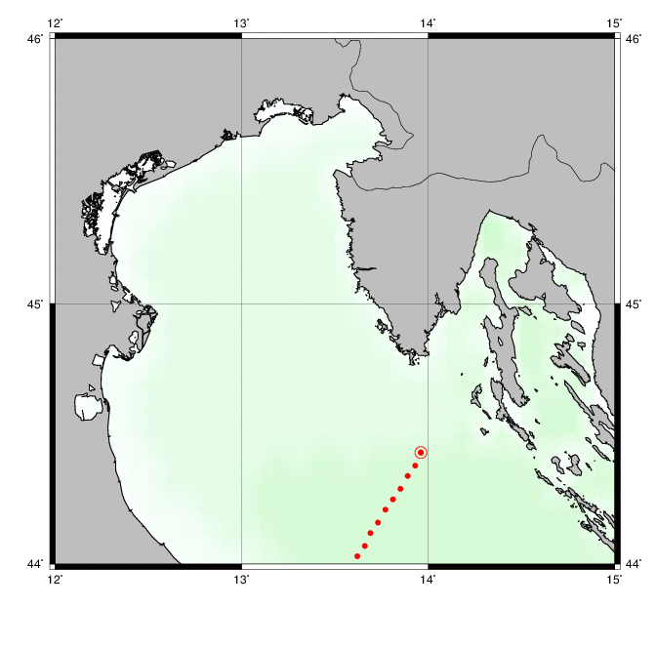
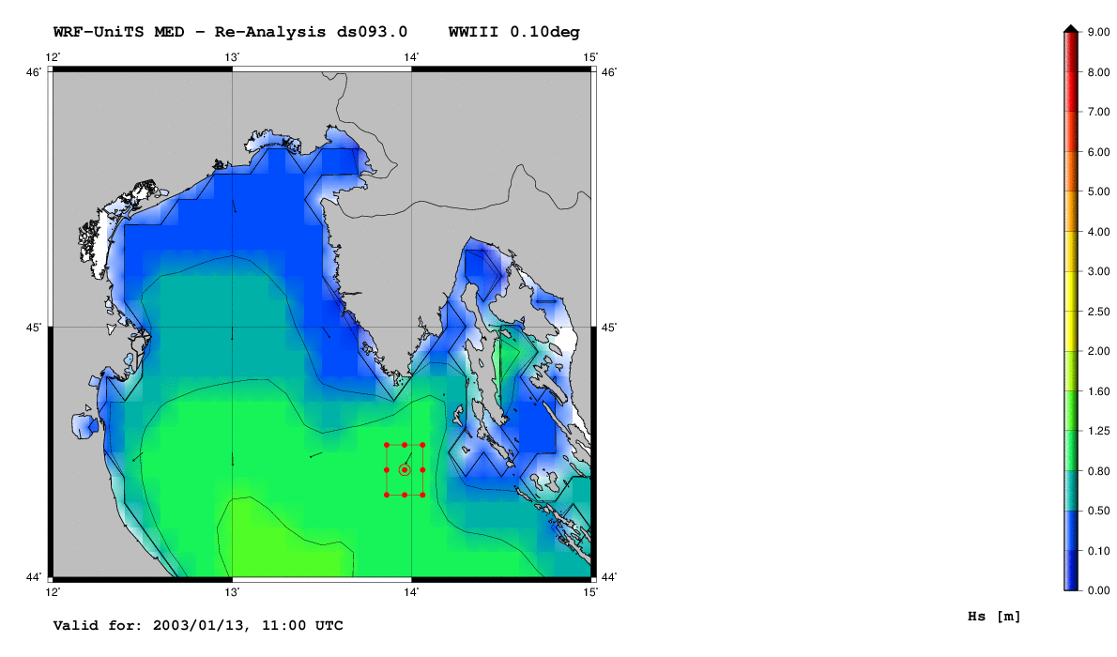
WIND-WAVE MODELS: MWM
Co-location comparison
Phase B
Satellite track
Model grid
t, λ(t), ϕ(t)
co-location (interpolation on model grid)
co-location + relaxation

Slide 13
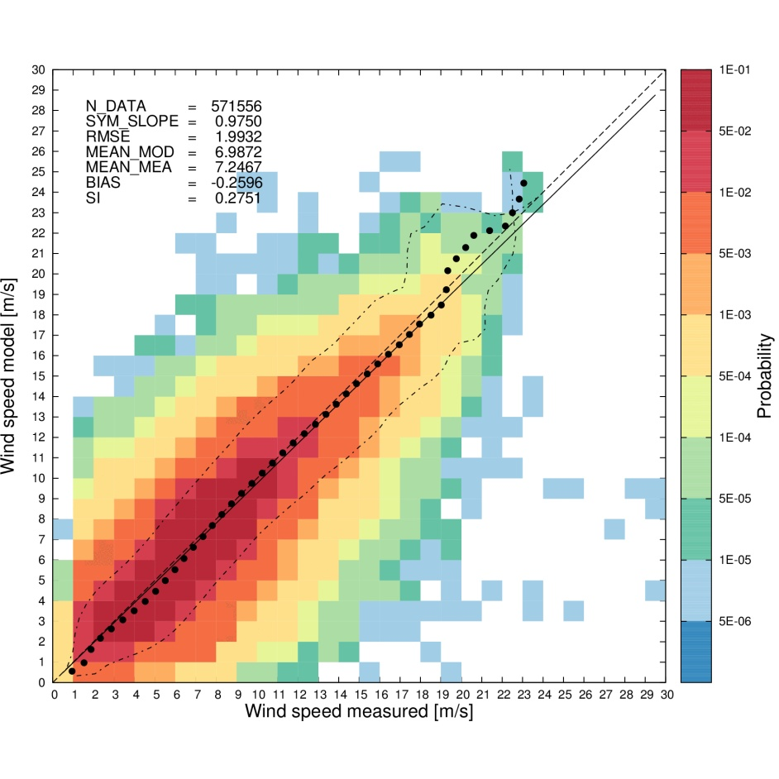
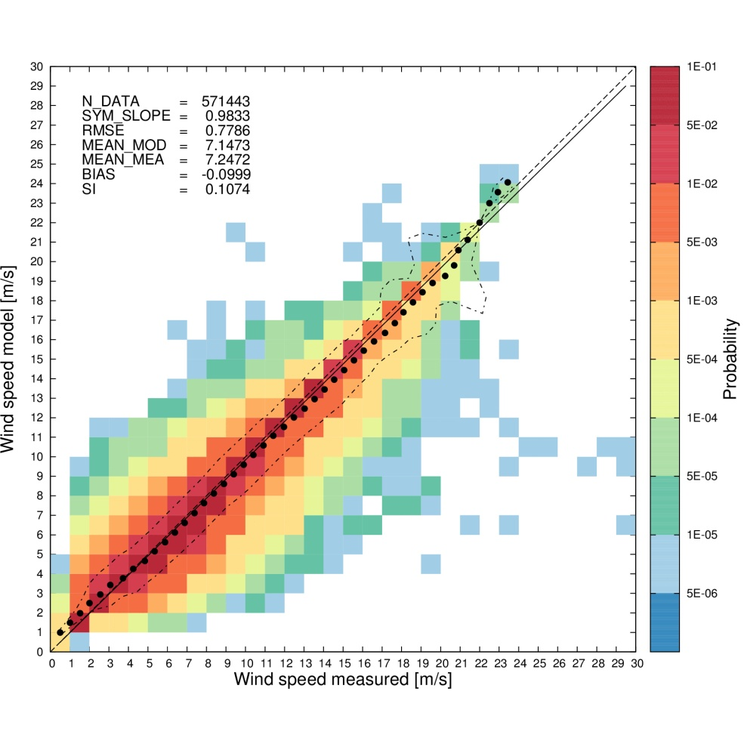
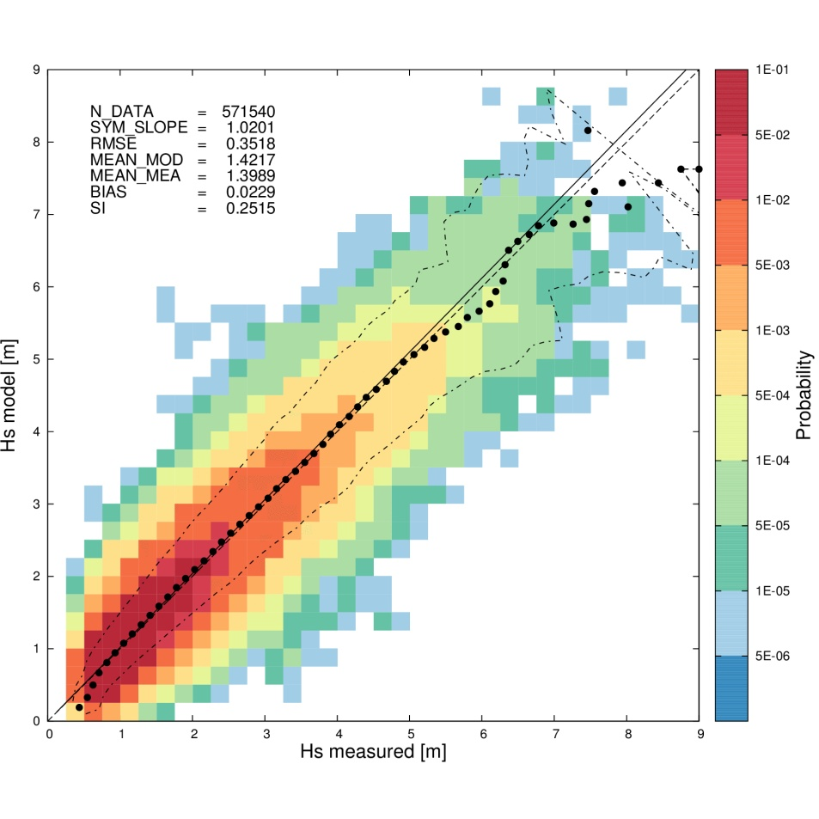
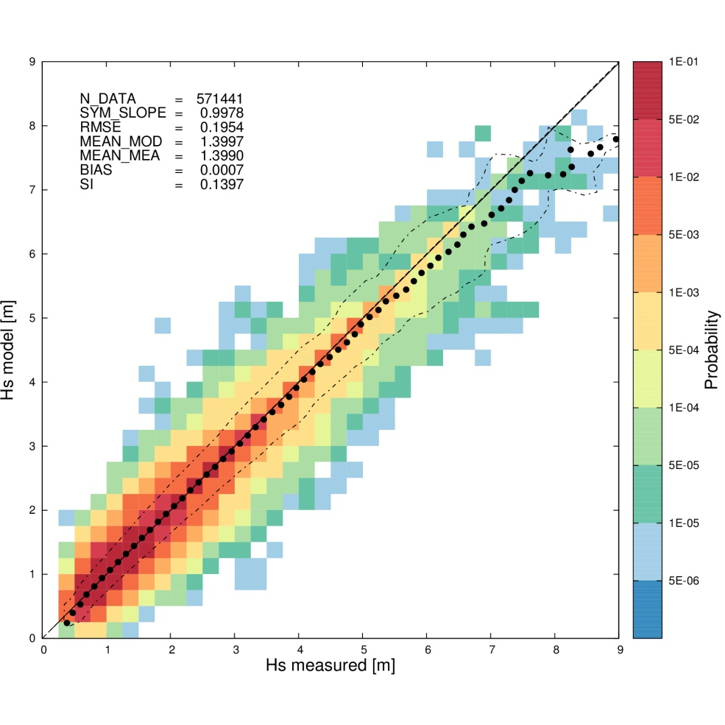
WIND-WAVE MODELS: MWM
Wind speed (10 m) | Significant wave height
ENVISAT
Phase B
co-location
co-location + relaxation

Slide 14
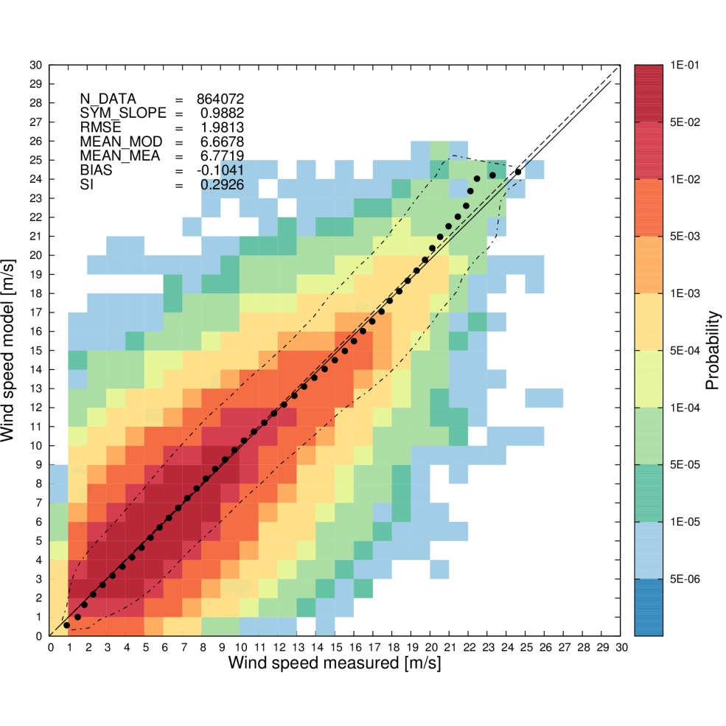
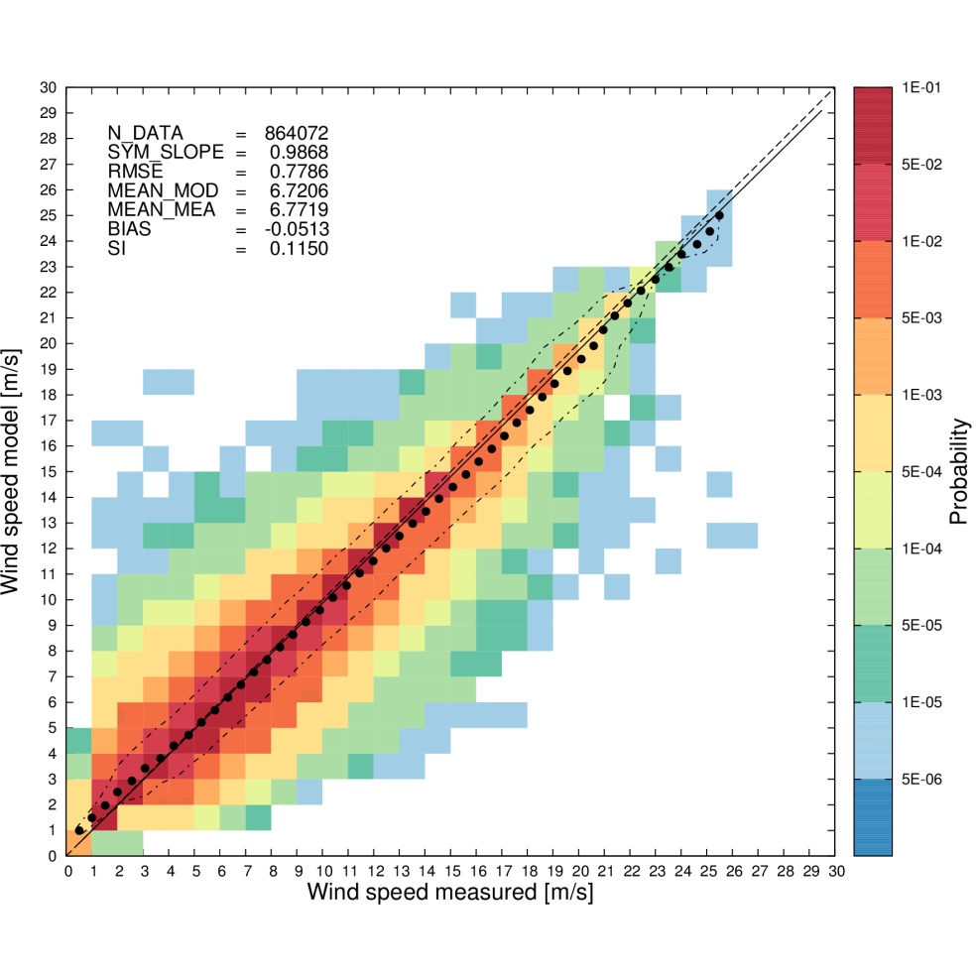
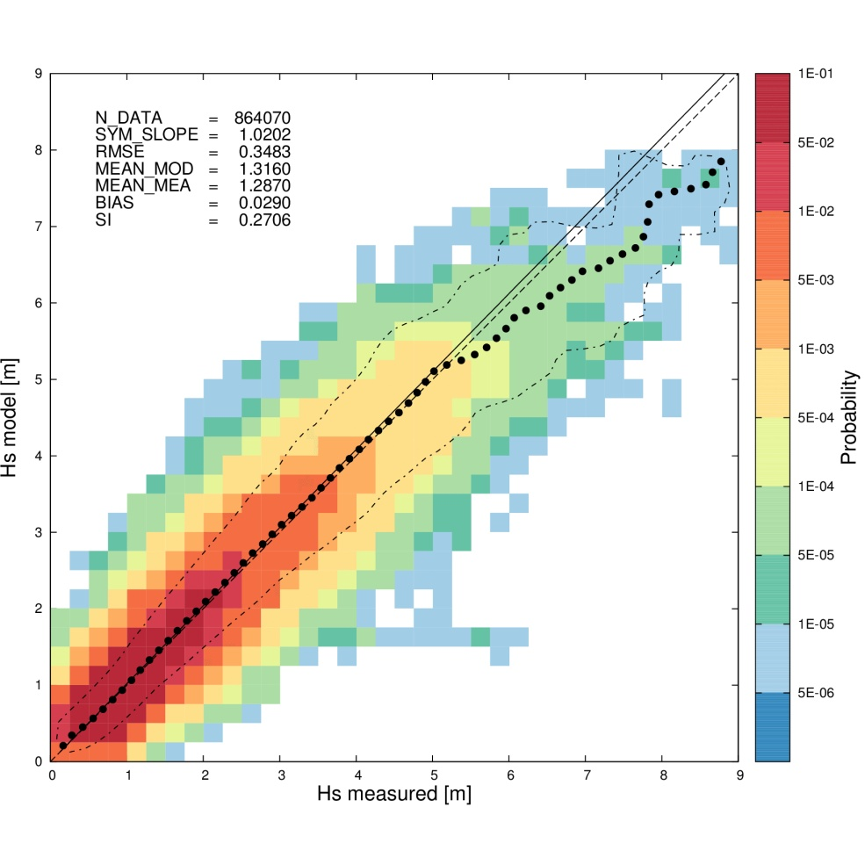
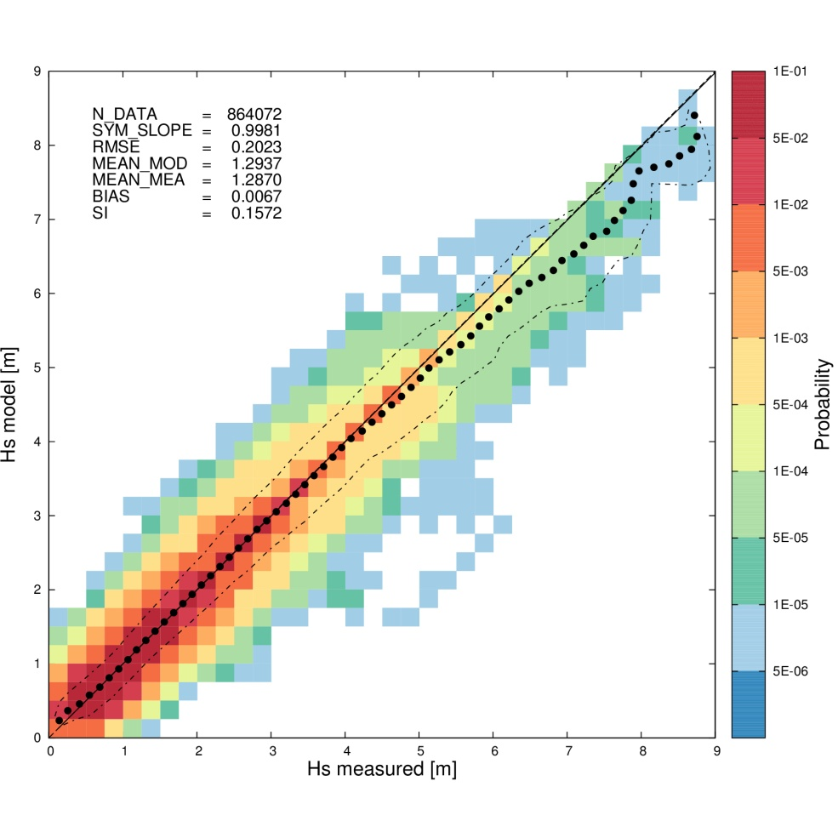
WIND-WAVE MODELS: MWM
Wind speed (10 m) | Significant wave height
JASON-1
Phase B
co-location
co-location + relaxation

Slide 15
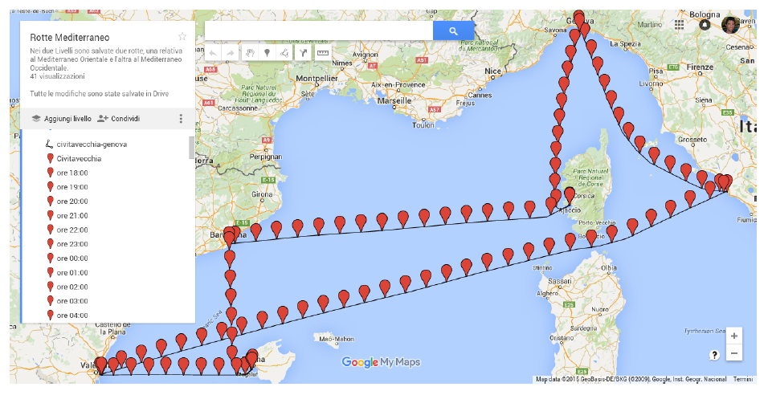
WIND-WAVE MODELS: WHY / Where / when
1) – Added power in waves: ship design
Weekly (Mediterranean) route (1 cycle) with a given ship speed profile
Period covered: 1979-2015 (1872 cycles)
Met-ocean (wind/waves) database HyMOLab + DHI (hourly – geo. resol. 0.1º)
For every mark, compute added resistance at time/position of the ship
Count the number of events with added power in waves greater than XX%

Slide 16
WIND-WAVE MODELS: MWM
CONCLUDING REMARKS
Space / time resolution
Accuracy: both wind-wave climate and storm peaks
Customization of the service (high res. model nesting, fast and cheap data delivery, …)
Expertise in dealing with ship/offshore/shore post-processing applications
…
HW ($ / handling / life cycle)
SW (set-up / testing / V&V)
Man hours
Storage / Database maintenance and updates
Security
…

Slide 17
WIND-WAVE MODELS: MWM
THANK YOU FOR YOUR ATTENTION
http://hymolab.units.it/
http://www.osmer.fvg.it/mare

Slide 18
WIND-WAVE MODELS: MWM
 | Task | Span | Validation Vs | State
A | Preliminary validation | 1 year (2000) | Ground stations & buoys | Completed
B | Extended validation | 11 years (2000 - 2010) | Satellites (altimeters) & buoys | Completed
C | Further improvements | 39 years (1979 - 2017) | Satellites (scattero/alti meters) & buoys | Continuous update
1979
1990
2000
2010
2017

Slide 19
WIND-WAVE MODELS: MWM
How to improve …?
Wind speed (10 m)
Significant wave height
All satellites
(altimeters only!)
Entire MED
Phase C

Slide 20
WIND-WAVE MODELS: MWM
How to improve …?
MAIN ISSUES:
the quality of the statistical (bias, RMSE) comparison (satellites) has a strong zonal dependence
the quality of the deterministic comparison (fixed stations) may show a directional dependence (orography, water depth)
Phase C

Slide 21
WIND-WAVE MODELS: MWM
How to improve …?
Model-Scatterometer (ASCAT) Vs Model-Altimeters (ALL)
Phase C
DATA AVAILABLE from ASCAT:
Wind speed (only) and direction
Huge number of data (>> 5000 data/cell (0.5°x 0.5°)

Slide 22
WIND-WAVE MODELS: MWM
How to improve …?
Phase C
CALIBRATION FOR WIND SPEED ONLY
FOR EACH CELL (0.5x0.5):
Cumulative probability for 8 directional sectors (N, NE, E, …), both Model and Scatterometer
Compute the calibration function for the model wind speed, for that cell and that directional sector
Generate the new wind fields for any (t, λ, ϕ)
Compare the new wind fields with other sources (altimeters, fixed/floating stations at sea)
Generate the new wave fields and compare the results with altimeters or wave buoys

Slide 23
WIND-WAVE MODELS: MWM
How to improve …?
Phase C
Bias without calibration
Bias with calibration

Slide 24
WIND-WAVE MODELS: MWM
How to improve …?
Phase C
Bias without calibration
Bias with calibration

Slide 25
WIND-WAVE MODELS: MWM
 | Task | Span | Validation Vs | State
A | Preliminary validation | 1 year (2000) | Ground stations & buoys | Completed
B | Extended validation | 11 years (2000 - 2010) | Satellites (altimeters) & buoys | Completed
C | Further improvements | 39 years (1979 - 2017) | Satellites (scattero/alti meters) & buoys | Continuous update
1979
1990
2000
2010
2017

Slide 26
WIND-WAVE MODELS: WHY / Where / when
1) – Added power in waves: ship design
Weekly (Mediterranean) route (1 cycle) with a given ship speed profile
Period covered: 1979-2015 (1872 cycles)
Met-ocean (wind/waves) database HyMOLab + DHI (hourly – geo. resol. 0.1º)
For every mark, compute added resistance at time/position of the ship
Count the number of events with added power in waves greater than XX%

Slide 27
WIND-WAVE MODELS: WHY / Where / when
2) - Operational efficiency: ship design

Slide 28
WIND-WAVE MODELS: WHY / Where / when
2) - Operational efficiency: ship design

Slide 29
WIND-WAVE MODELS: WHY / Where / when
2) - Operational efficiency: ship design
Operational efficiency
Metocean model
For every:
GeoP (121)
Mean wave dir (16)
3) Ship speed (6)
Route (16)
ShipP (4 * criteria)
Wave Statistics
Time series
Hs
Tp

Slide 30
WIND-WAVE MODELS: WHY / Where / when
2) - Operational efficiency: ship design
Contento, G., Mocnik,F., Lupieri, G., Parapetto, M., Catapano, G., 2012, Operational Efficiency at Sea of a New Oceanographic Vessel at the Design Stage: A Detailed Study Over the Central Mediterranean Sea Using Medium Resolution Hindcast Wave Data, NAV 2012 - 17th International Conference on Ships and Shipping Research, pg 111-112 (full paper on CD).

Slide 31
WIND-WAVE MODELS: WHY / Where / when
4) - Harbour activities: downtime reduction

Slide 32
WIND-WAVE MODELS: MWM
CONCLUDING REMARKS
Space / time resolution
Accuracy: both wind-wave climate and storm peaks
Customization of the service (high res. model nesting, fast and cheap data delivery, …)
Expertise in dealing with ship/offshore/shore post-processing applications
…
HW ($ / handling / life cycle)
SW (set-up / testing / V&V)
Man hours
Storage / Database maintenance and updates
Security
…

Slide 33
WIND-WAVE MODELS: MWM
THANK YOU FOR YOUR ATTENTION
http://hymolab.units.it/
http://www.osmer.fvg.it/mare

Slide 34
WIND-WAVE MODELS: MAjor PROJECTS @ UniTS + DHI
HINDCAST
Project (Site) Customer
SEAPOL DHI Italia
BONACCIA (Adriatic Sea) SAIPEM SpA
PIPELINE DECOMISSIONING AECOM
PORTO DI CIVITAVECCHIA ENEL SpA
PORTO DI MONTECARLO (FR) DHI France
PON SIGIEC UNIV. CALABRIA
PORTI LAZIALI UNIV. LA SAPIENZA
SAND ENGINE (Adriatico) ENI SpA
PORTO DI TARANTO SAIPEM SpA
COMETA FINCANTIERI SpA
GOLFO LEONE DHI France
IBLEO ENI SpA
NOTO DHI Italia
ISRAELE DHI srl
EGITTO SAIPEM SpA
MILAZZO AECOM URS
GELA ENI SpA
SCIACCA INVITALIA
CIPRO SAIPEM SpA
GENOVA HYDRODATA
Golfo del Leone CORINTHE INGEGNERIE
Giulianova PROVVEDITORATO LAZIO
Senigallia GEOMARINE
Progetto START LINKS
Egitto DHI DK
Marche GENIO CIVILE ANCONA
Mare Egeo DHI DK
Gallipoli ACQUEDOTTO PUGLIESE
OPERATIONAL FORECAST
Project (Site) Customer
SEAPOL DHI Italia
Harbour of TREMESTIERI (Sicily) Port Authority MESSINA
SAND ENGINE ADRIATICO ENI SpA
MARE - ARPA FVG – OSMER ARPA FVG – OSMER
SAND ENGINE GELA ENI SpA

Slide 35
WIND-WAVE MODELS: WHY / Where / when
3) – Offshore operations: safety/efficiency

Slide 36
WIND-WAVE MODELS: WHY / Where / when
3) – Offshore operations: safety/efficiency

Slide 37
WIND-WAVE MODELS: WHY / Where / when
3) – Offshore operations: safety/efficiency/emergency

Slide 38
WIND-WAVE MODELS: WHY / Where / when
4) - Harbour strategic plan: environmental impact

Slide 39
WIND-WAVE MODELS: WHY / Where / when
5) – Meteorological hazards: civil protection…
Wind pattern (10m above ground) of a squall occurred on August 2008 in the Gulf of Trieste.
Comparison of the wind speed obtained by the model forecast and the measurements station Paloma approximately in the middle of the Gulf. Meteorological model resolution 2.2 km

Slide 40
WIND-WAVE MODELS: WHY / Where / when
http://hymolab.units.it/index.php
5) – Meteorological hazards: civil protection…
Time series of the wind speed during the squall at the measurements station PALOMA (45°37' 06” N, 13°33' 55” E) [http://www.ts.ismar.cnr.it/node/84].
The red line corresponds to the results of the operational forecast meteorological model WRF-ARW.
The black line corresponds to the measurement at the station.
The measured wind speed is 5 min averaged with 5 min samples. The time step of the model is approximately 13 s.

