Slide 1
EMODnet now and in future
Trieste, 8 June 2018

Slide 2
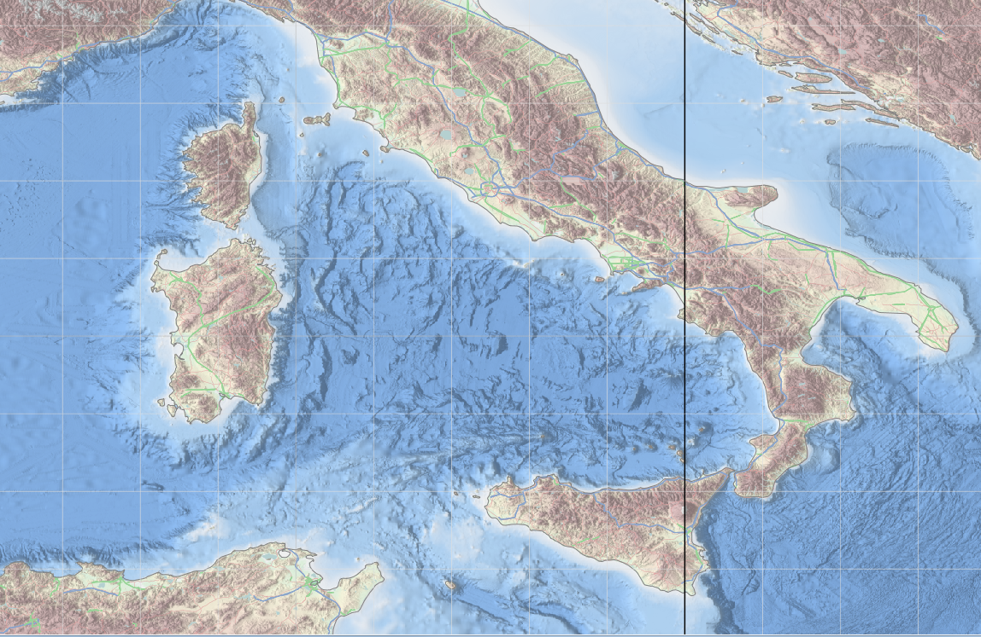
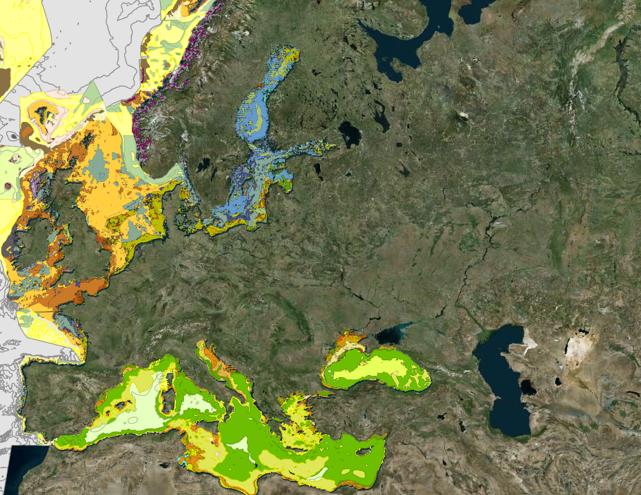
3 Objectives
increase productivity
reduce uncertainty
promote innovation

Slide 3
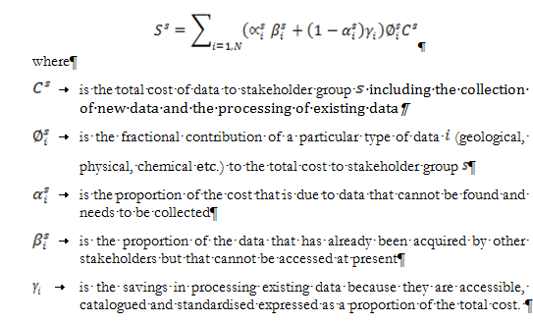
productivity gain

Slide 4
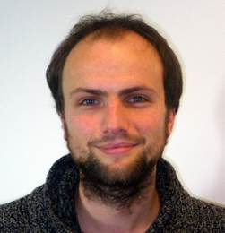
productivity gain
productivity
EMODnet prime source of bathymetry data
high resolution and quality,
quick availability.
Dr Thijs Lanckriet, Advisor, International Marine and Dredging Consultants
Applications
simulations of tsunami propagation for nuclear facility on the Dutch coast
feasibility studies for an LNG terminal in Croatia
hydrodynamic model of the Mediterranean Sea basin

Slide 5
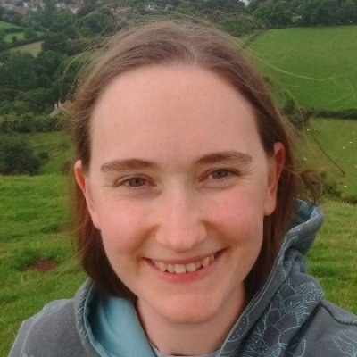
reduction of uncertainty
EMODnet topographic maps have made massive improvements to our storm surge forecasts
Dr. Clare O'Neill UK Meteorological Office
Notes:
The partnership producing the topographic maps is led by the French Service hydrographique et océanographique de la Marine (SHOM) who are also leading our cross-border spatial planning projects
We ar e selecting members for an expert group representing business in order to ensure we meet their needs.
We now have probably the most advanced system for good stewardship of marine data. We now want to bring international partners onboard. Discussions starting with Chinese on a "maritime silk road information system"

Slide 6
innovation gain
Hackathon Antwerp
November 2017

Slide 7
Post 2020
Commission proposal for European Maritime and Fisheries Fund to be adopted next week

